Slide 1
Fraud Detection
Radhika Raghuwanshi - G32395729
Notes:
Hi, I am Radhika Raghuwanshi and my project is Fraud detection using graph based algorithms

Slide 2
Fraud Detection in Credit Card Transactions
Credit card fraud occurs when someone illegally uses another person's credit card information to make purchases or withdraw funds without authorization
Lost/Stolen Card Fraud
Card-Not-Present (CNP) Fraud
Synthetic Identity Fraud
Credit card fraud has grown into a global issue, with billions lost each year due to unauthorized transactions.
Customers rely on banks to keep their finances safe. Every fraudulent transaction erodes this trust and raises security concerns, potentially impacting customer loyalty and satisfaction.
Notes:
So let’s talk about why Fraud detection is crucial for credit card transactions.
Fraudulent activities, such as Lost/Stolen Card Fraud, Card-Not-Present (CNP) Fraud, and Synthetic Identity Fraud, are growing global concerns, costing billions annually in unauthorized transactions.
Effective fraud detection helps protect customer finances, ensuring their trust in the banking system remains intact. Each incident of undetected fraud not only results in financial losses but also undermines customer confidence and loyalty which emphasizes the need for robust security measures to maintain satisfaction and mitigate risks.

Slide 3
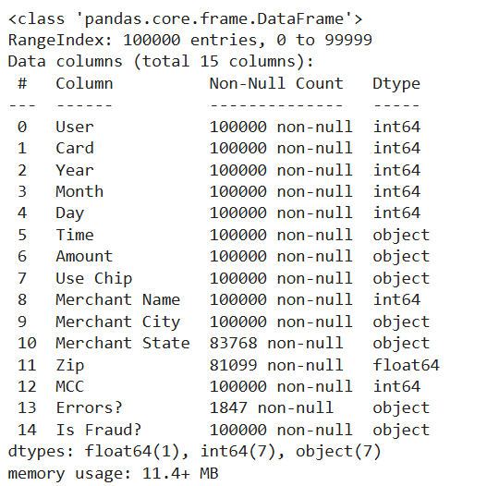
Dataset Information
Source: IBM Credit Card Transactions Dataset
Data Size:
24 million transactions
6,000 unique merchants
100,000 unique cardholders

Slide 4
Pre Processing Steps
Data Sampling : Due to computational limitations, a sample of 100,000 records will be used from the dataset
Binary Conversion: Convert the target column “Is Fraud? “ to binary (1 for fraud, 0 for non-fraud)
Unique Card ID: Combine User and Card columns to create a distinct card_id.
Amount Conversion: Clean Amount by removing $ symbol and converting it to float.
Handling Missing Data:
Impute missing values “in Errors? “ column with "No error".
Drop Columns: Remove Merchant State and Zip due to high missing data and redundancy.

Slide 5
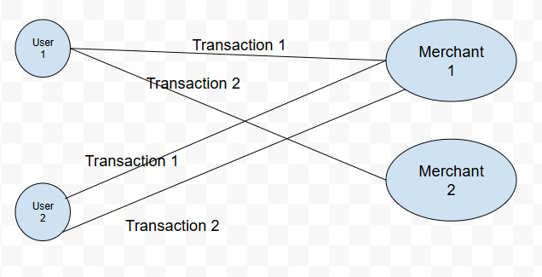
Model Implementation: GNN
Graph Representation:
Nodes represent users and merchants.
Edges represent transactions between them.

Slide 6
Model Implementation
Graph Neural Network (GNN) (baseline)
Graph Representation: User and merchant represent nodes; edges represent between transactions between them
Message Passing: Node features are propagated through the network, allowing the model to learn patterns from neighbors.
Model Setup:
Used a simple GNN architecture with multiple layers for message passing.

Slide 7
Model Implementation
Graph Attention Networks (GAT)
Attention Mechanism: Unlike standard GNNs, GAT uses attention to weigh the importance of neighboring nodes dynamically.
Improved Fraud Detection: GAT focuses more on the most relevant nodes (e.g., transactions with high fraud potential).
Key Feature: The attention mechanism enables the model to prioritize fraud-prone relationships and capture more complex patterns.
Model Setup:
Used multi-head attention layers.
Learned to attend to different neighbors based on their importance to fraud detection

Slide 8
Model Implementation
GraphSAGE (Graph Sample and Aggregation)
Sampling & Aggregation: GraphSAGE samples neighboring nodes and aggregates information
Fraud Detection Focus: Aggregates relevant node information to predict fraud for each transaction.
Model Setup:
Implemented the mean aggregation function.
Used hidden layers for learning complex patterns and generating fraud predictions.

Slide 9
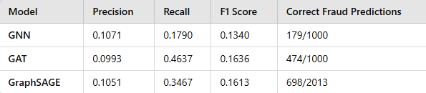
Model Evaluation
GNN:
The GNN model performed reasonably
well in identifying fraudulent
transactions, but its
performance was limited by its inability to
focus on
more complex fraud patterns.
The lower recall and F1 score suggest that the model missed a significant portion of fraudulent transactions.
Notes:
Although the performance of these models may not seem particularly high in terms of precision, recall, and F1 score, the results are competitive when compared to the state-of-the-art in similar tasks, where the highest precision achieved on this dataset has been around 0.21.

Slide 10
Model Evaluation
GAT:
GAT outperformed GNN in terms of recall,
demonstrating its ability to
focus on fraud-prone nodes due to the attention
mechanism.
The higher recall indicates better
identification of fraudulent transactions, but precision was still a challenge, leading to false positives.

Slide 11
Model Evaluation
GraphSAGE showed good performance
with a fraud detection rate of 0.35
and
a relatively good accuracy of detecting fraud cases.
Despite a moderate recall, its ability to
aggregate information from neighboring
nodes made it suitable for large datasets.

Slide 12
Challenges
Large Dataset
Problem: The IBM Credit Card Transactions dataset contains 24 million transactions, posing significant computational challenges.
Solution: Due to system limitations, a sample of 100,000 records was used for processing.
Imbalanced Classes
Problem: Fraudulent transactions are much less frequent than non-fraudulent transactions, leading to class imbalance.
Impact: This imbalance makes it harder for models to detect fraud and can result in high false negative rates.
Solution: Techniques like oversampling, undersampling, and class weighting were explored to address the imbalance.

Slide 13
Conclusion
In this study, we compared three Graph Neural Network (GNN)-based models—GNN, GAT, and GraphSAGE—for fraud detection using the IBM Credit Card Transactions dataset. Although the models' performance in terms of precision, recall, and F1 score might not seem high, they remain competitive with state-of-the-art results, where the highest precision on this dataset has been around 0.21.
GAT emerged as the best model with the highest recall (0.4637), benefiting from its attention mechanism that focused more on fraudulent transactions, helping it handle the imbalanced dataset effectively.
GraphSAGE demonstrated a good balance between precision (0.1051) and recall (0.3467), detecting good amount of fraud cases ,thanks to its neighborhood aggregation approach, which enhanced fraud pattern recognition.
GNN performed the weakest, with lower recall (0.1790) and precision (0.1071), likely due to its less focused approach on fraud detection compared to GAT’s attention mechanism and GraphSAGE’s neighborhood aggregation.
Overall, GAT’s attention mechanism proved to be particularly effective in improving fraud detection in imbalanced datasets.

Slide 14
Thank You!

